Slide 1
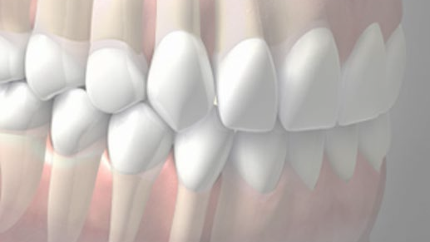

RUNGTA COLLEGE OF DENTAL SCIENCES & RESEARCH
DEPARTMENT OF CONSERVATIVE DENTISTRY AND ENDODONTICS
1

Slide 2
Specific learning Objectives
At the end of this presentation the learner is expected to know ;
Core areas* | Domain ** | Category #
ANATOMY OF PERIAPEX CEMENTUM PERIODOTAL LIGAMENT INGLES CLASSIFICATION ZONES OF FISH | COGNITIVE | MUST KNOW
PATHWAY OF ENTRY OF MICROORGANISMS IN TOOTH | PSYCHOMOTOR | NICE TO KNOW
DIAGNOSIS OF PERIAPICAL TISSUE ENDO PERIO LESSIONS | AFFECTIVE | DESIRE TO KNOW

Slide 3
Contents
Introduction
Contacts
Definition of contact area
Types of contacts
Proximal Contact Area
Contact areas based on Shape of tooth
Changes in contact with age
Hazards of faulty reproduction of contact of teeth in restorations
Open contacts
Contours
Functions of contour
Height of Contour
3

Slide 4
Types of contour
Functions of contour
Age changes
Hazards of improper proximal contour relationship
Hazards of improper contours on restoration
Management of improper contours
Embrasures
Functions of embrasures
Hazards of faulty embrasures
Marginal ridges
Functions
Procedures for formulation of proper contacts and contours:
Tooth movement
Objectives

Slide 5
Rapid / Immediate movement
Methods
Wedge method
Classification of wedges
Functions of wedges
Wedging techniques
Error’s with wedge placement
Test for proper wedge placement
Elliots separator
Traction method
Non-Interfering true separator
Ferrier double-bow separator
5

Slide 6
Slow/ Delayed tooth movement
Methods:
Separating wires
Oversized temporaries
Orthodontic appliances
Matricing
Classification of matrices
Matrix Band and retainer
Qualities of a good matrix
Universal Matrix (Tofflemire matrix)
Ivory Matrix No.1
Ivory Matrix No. 8
Black’s matrices
Copper Band Matrix / Soldered Band

Slide 7
Anatomical Matrix
Roll in band matrix ( Automatrix)
S-shaped Matrix Band
T-shaped matrix
Mylar Strips
Aluminium Foil Incisal Corner Matrix
Transparent Crown Form Matrix
Window Matrix
Preformed Transparent Cervical Matrix
Recent Advances
Contact Forming Instruments
Contact Rings
First generation systems
Second - Generation Rings
Metafix Matrix System
Bioclear Matrix system
Fender Wedges
Slick Bands
Conclusion
References
Notes:
Palodent Bitine
Contact matrix
Composi-Tight
Composi-Tight 3D soft face ring system
V3 ring system

Slide 8
Contours
Convexities on the facial & lingual surfaces of tooth that affords protection & stimulation of the supporting tissues during mastication.
Functions of contour:
Deflecting food
Maintenance of periodontal tissues
Maintain contact with adjacent tooth
8

Slide 9


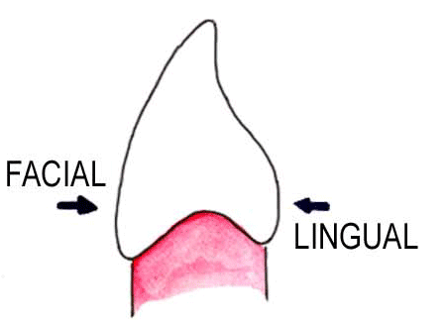
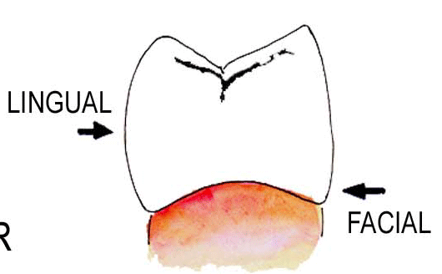
Height of Contour
Area of greatest circumference on the facial and lingual surface of the teeth.
Protects the gingival tissue by preventing food impaction.
ANTERIOR |  | POSTERIOR
 | Cervical 3rd on facial & lingual surface |  | Gingival 3rd on facial surface Middle 3rd on lingual surface
9

Slide 10

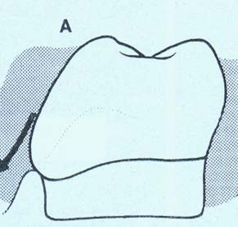

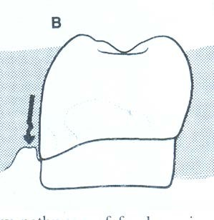

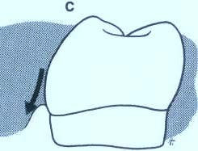
Types of contour
OVERCONTOUR
Deflects food away from gingiva Understimulation of supporting tissues Plaque accumulation
UNDERCONTOUR
Irritation to soft tissues
ADEQUATE CONTOUR
Stimulation of supporting tissues Healthy peridontium
10

Slide 11
Functions
Acts in deflecting food only to the extent that passing food stimulates gentle massaging rather than irritates the investing tissues.
Maintainance of periodontal tissues.
Proximal height of contour screen to provide contacts with proximal surfaces of the adjacent teeth which prevents food impaction.
Also provide adequate embrasure space gingivally of the contacts for gingival tissues, supporting tissues
Upper anterior teeth - essential determinant for mandibular movement.
Serves to decrease the tooth bulk from its gingival third to incisal third.

Slide 12
Age changes
In young children, most curvatures, buccal and lingual lie beneath the gingiva and as the teeth erupt, the curvature becomes more clinically apparent.
In normal adults whose tooth eruption has been completed, the gingival crest is cervical to the buccal and labial contours of all maxillary teeth and lingual contour of anterior teeth.
Normal amount of curvature
Facial -> 0.5 mm
Less lingually on the anterior teeth.
Mandibular posterior teeth – 1mm
Mandibular anterior -> less than 0.5 mm
canines -> more than that of central and lateral incisors.

Slide 13
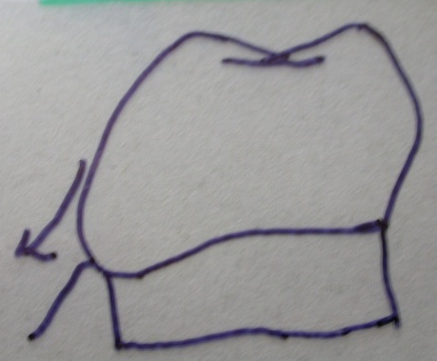
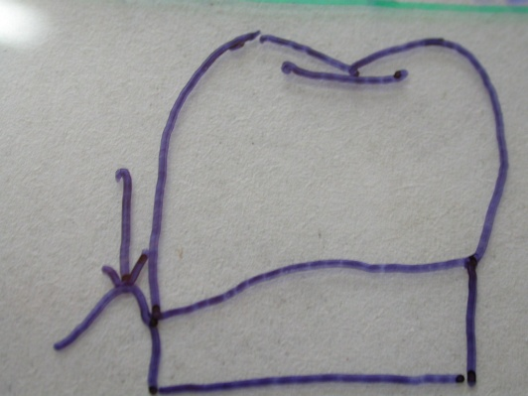
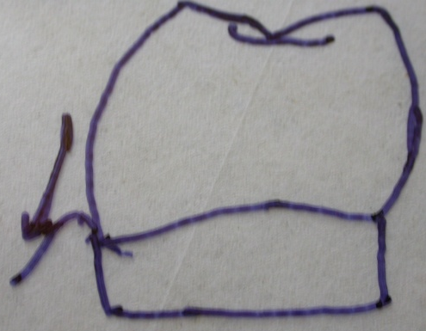
Hazards of improper proximal contour relationship.
Over contour under contour correct contour
Deflects food from gingiva
* Irritation of soft tissue * Adequate stimulation of supporting tissues
Under stimulation of
supporting tissues gingival inflammation
Healthy condition
Circulation and growth of
Cariogenic & plaque
ingredients

Slide 14
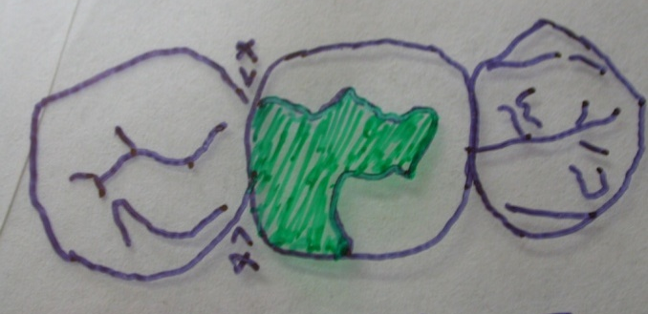
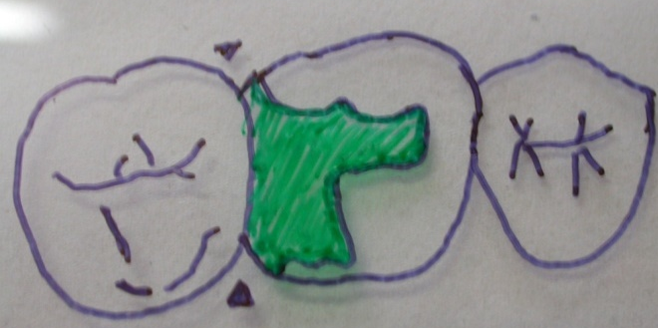
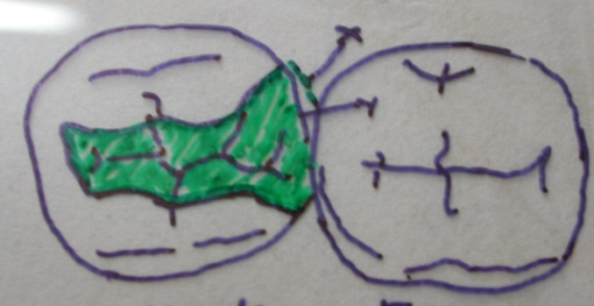
HAZARDS OF IMPROPER CONTOURS ON RESTORATION
Normal contour over contour under contour
Improper contours on restorations
Restoration overhangs
Impinge the space normally occupied by gingiva.
Inflammation, soreness and food entrapment.

Slide 15
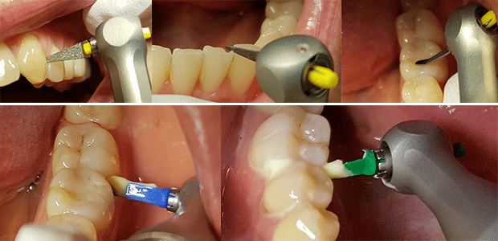
Managements
Over contoured proximal contour
Recontour if possible
Files, trimmer
Wedelstaedt chisel or bard parker No. 12 blade.
Rotary instruments
* Sand disks
* Flame shaped finishing burs
Subgingival contours
Low speed reciprocating action hand piece system –
Eva system using wedge shaped files.
Undercontoured Proximal contour
Replace the restoration

Slide 16

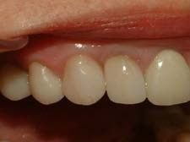
Embrasures (spillways)
V-shaped spaces between the teeth that originate at the proximal contact areas between adjacent teeth.
Serves 2 purposes:
Provides a spillway for passage of food during mastication
Prevents food from being forced into the contact area
16
Notes:
Curvature formed by two adjacent teeth in an arch form a spillway space that is called an embrasure.

Slide 17

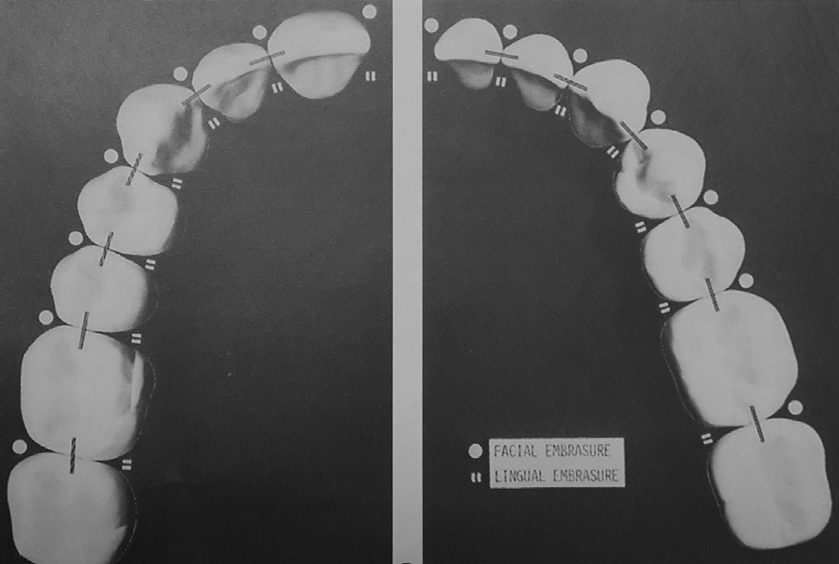

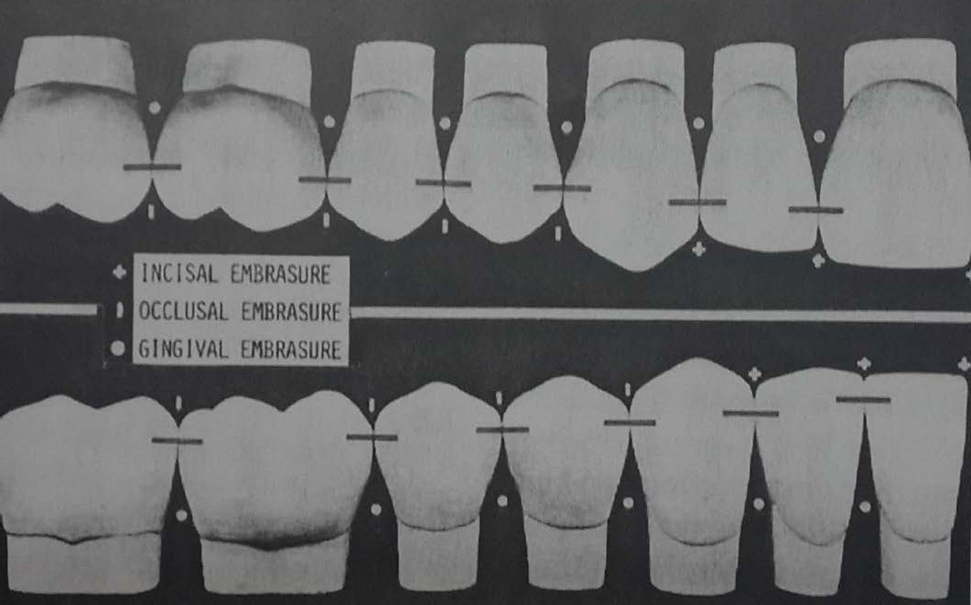
Named for the direction towards which they radicate:
facial, lingual, incisal/occlusal, gingival
Facial/Buccal
Incisal/Occlusal
Lingual/Palatal
Gingival
18

Slide 18

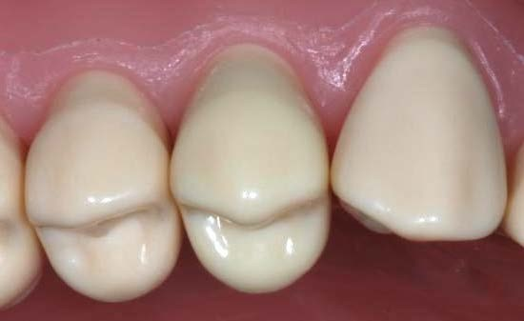
Gingival embrasures filled with papilla – prevents food being trapped in this region
Anterior
Posterior
: papilla is triangular
: tent shaped (col)
Correct relationship of embrasures, cusps, sulci, marginal ridges & grooves of adjacent and opposing tooth provide escape of food from the occlusal surface during mastication
18

Slide 19
Embrassure is reduced: additional stress is created in teeth & supporting structures.
Embrassures is large: less protection to supporting structures
Lingual embrasure is greater than buccal, since tongue can displace food occlusally.
19

Slide 20
Functions
Makes spillway for escape of food during mastication, thus decrease forces brought to bear upon the teeth during the reduction of any material that offers resistance.
Prevents food from being forced through contact area,thus keep food from being packed between the teeth.
Reduce the forces of occlusal trauma brought to bear at the teeth thus dissipate and reduces occlusal forces
Permit slight amount of stimulation to the gingiva by frictional massage of food, thus protecting gingiva from undue trauma

Slide 21
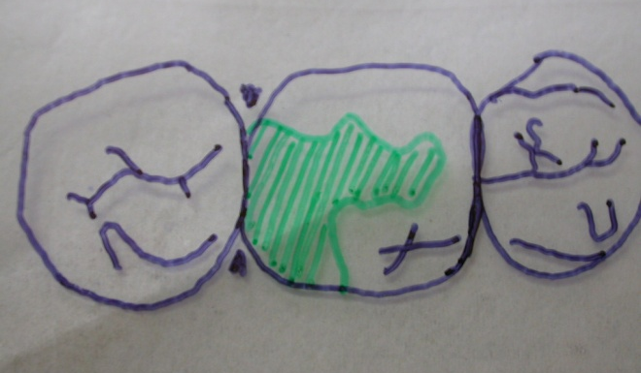
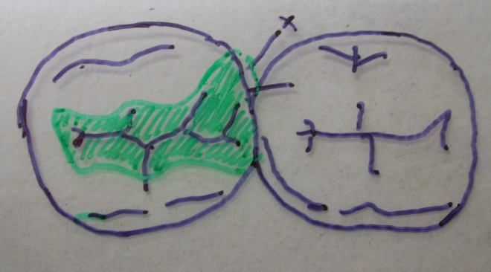
HAZARDS OF FAULTY EMBRASSURES
Decrease or absent
Additional stress created in the teeth and supporting structures during
mastication
Too large
Little protection to the supporting structures as food is forced into the
interproximal surface by an opposing cusp .
Failure to understand and adhere to correct anatomic form in the performance of restorative procedures. Breakdown of stomatognathic system.

Slide 22

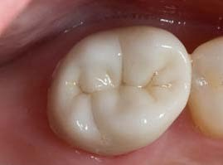
Marginal Ridges
Rounded borders of enamel that forms the mesial & distal margins of occlusal surfaces of molars & premolars and the mesial and distal margins of lingual surfaces of incisors and canine.
Always formed in 2 planes: buccolingually meeting at a very obtuse angle
This feature is essential when an opposing functional cusp occludes with the marginal ridge.
22

Slide 23
Functions:
Helps in prevention of food impaction proximally
Mastication
Protection of peridontium
Marginal ridges of adjacent posterior teeth should be at the same height to have a proper contact and embrasure forms.
23

Slide 24

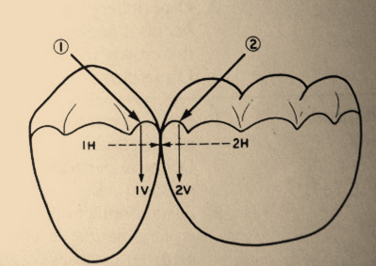
Marginal ridges with normal occlusal

Slide 25

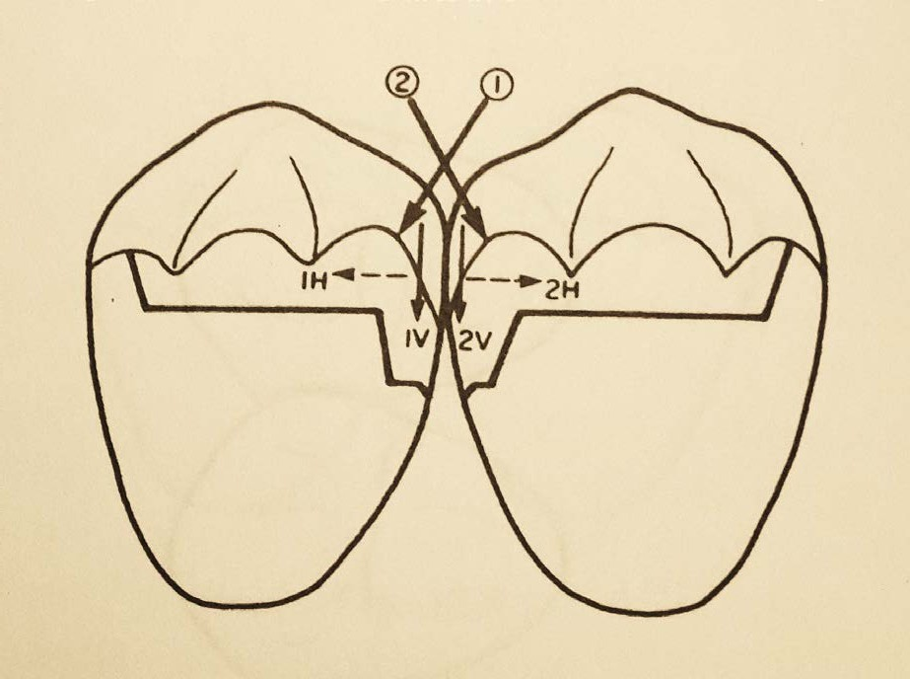
Marginal ridges with exaggerated occlusal embrasures causes drifting of tooth which leads to wedging of food
25

Slide 26


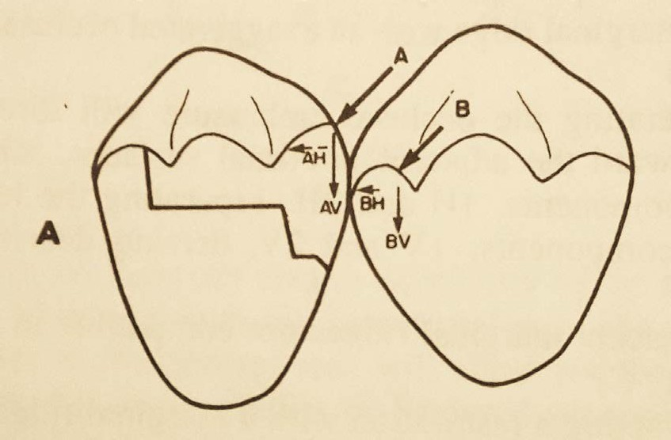
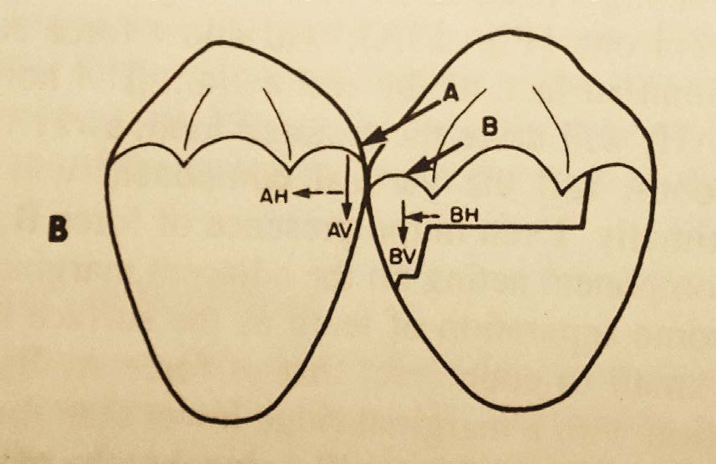
Adjacent marginal ridges are not compatible in height - drives the debris interproximally.
26

Slide 27

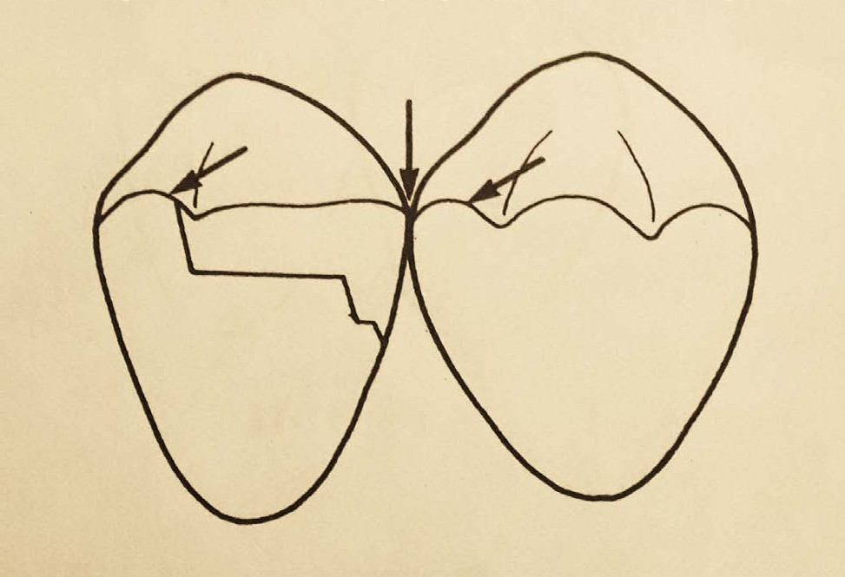
Marginal ridges with no triangular fossa, the vertical forces will impact food interproximally.
27

Slide 28

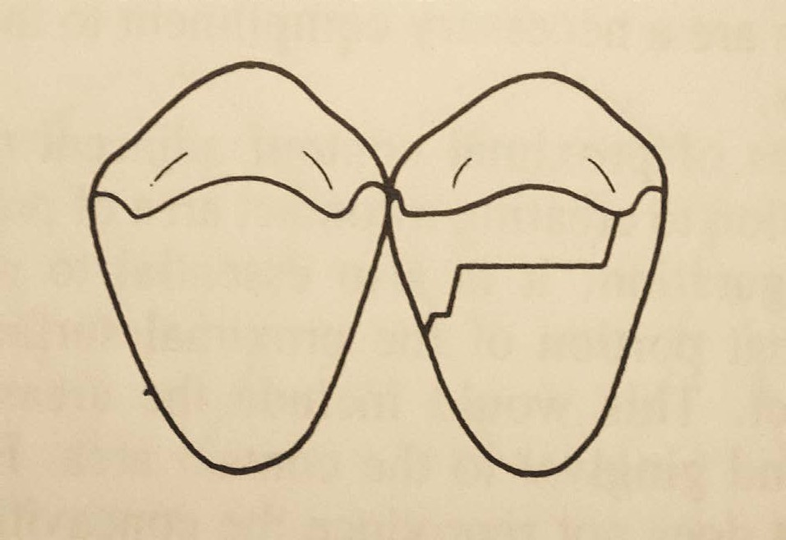
Thin marginal ridges will be susceptible to fracture or deformation
28

Slide 29

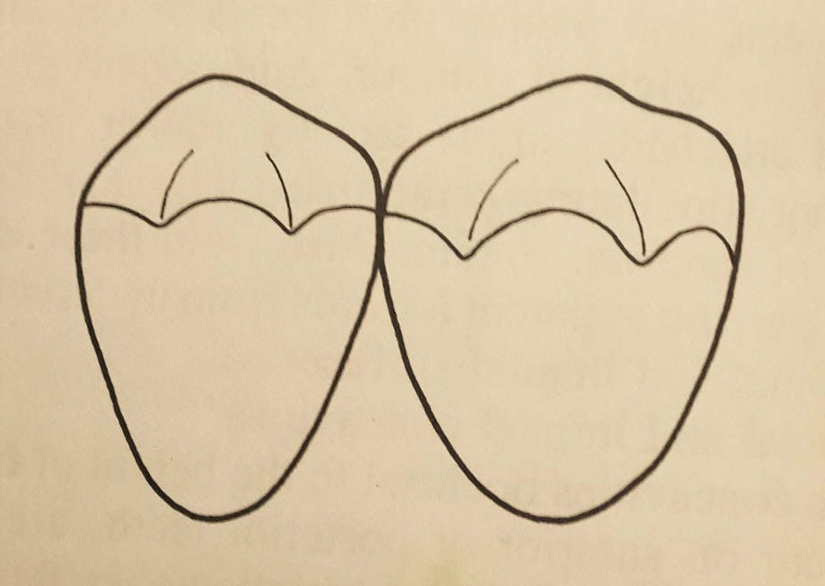
Marginal ridges with no occlusal embrasures, the 2 adjacent marginal ridges will act like a pair of tweezers grasping the food substance passing over it.
29

Slide 30
Procedures of proper contacts & contours
Intraoral procedures:
Tooth movement
Matricing
30

Slide 31
CLASSIFICATION
Intra oral procedures Extra oral procedures
Tooth movement matricing wax pattern
cast adjustment
Rapid or immediate Slow or delayed
Separating wires
Wedge method
Wood or plastic
Ferrier double bow separates
Traction principle Over sized temporaries
Elliot separator
Non interfering true separator
Orthodontic appliances

Slide 32
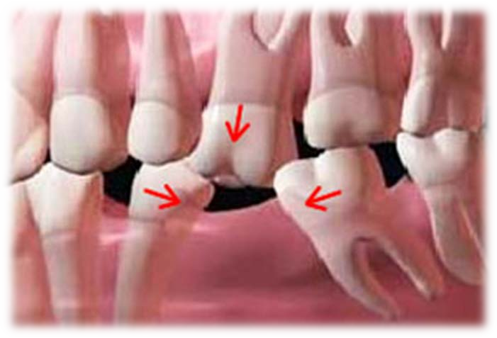
Tooth movement
Act of separating the involved teeth from each other, bringing them closer to each other or changing their spatial position in one or more dimensions.
32

Slide 33
Objectives:
To bring drifted, tilted or physiological positions
rotated teeth to their indicated
To close space between teeth restoration
not amenable to closure by
To move the teeth occlusally or apically to make them restorable.
To move teeth from a non-functional or traumatically functional location to a physiologically functional one.
33

Slide 34
To move teeth to a position so that when restored, they will be in a most esthetically pleasing situation.
To move teeth in a direction and to a location to increase the dimensions of available structure for resistance and retention form.
To create sufficient space for thickness of matrix band.
34

Slide 35
Tooth Movement
Rapid / Immediate
Slow / Delayed
35

Slide 36
Rapid/ Immediate movement
Mechanical type of separation
Creates either proximal separation at the point of separator’s introduction and/or improved closeness of proximal surface of opposite side.
Indications:
As preparatory to slow movement
To maintain the space gained by slow movement
Separation shouldn’t exceed the thickness of the involved tooth’s periodontal ligament thickness. ie: 0.2 – 0.5 mm
36

Slide 37
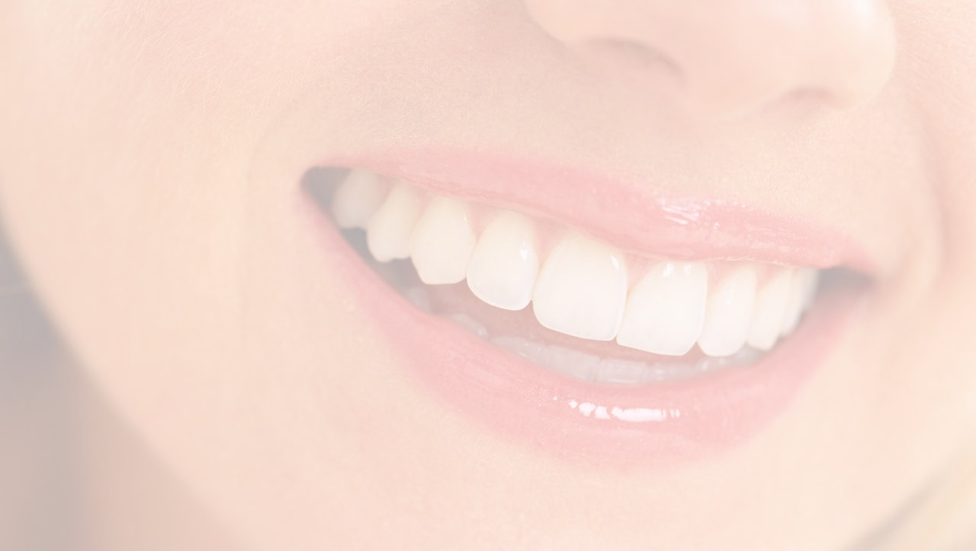
Conclusion
Proper restoration of the anatomical landmarks is important for enhancing the longevity of restorations as well as to maintain the occlusal health and harmony.
Matricing is a vital step during the placement of different restorations.
Selection of the matrix should be based on its ease of use and efficiency to provide the optimum contacts and contours..
The dentist should select the right method according to the needs of individual case.
37

Slide 38
TAKE HOME MESSEGE
Some of the problems that dentists face in their clinical practice are caused or facilitated by improper (but sometimes even proper) treatment of the root canal system. In an attempt to accomplish the major goals of root canal treatment, namely to prevent and/or to control endodontic infections, clinicians use procedures, substances and materials that may induce some degree of injury to the periradicular tissues. Invariably, periradicular tissue healing will occur uneventfully in cases where microorganisms were successfully eliminated from and/or prevented from gaining entry into the root canal system and minimal or no damage was inflicted on the periradicular tissues during therapy. The worst-case scenario for periradicular tissue response to intra-canal procedures is reflected largely in post-operative pain and persistence of periradicular disease despite treatment. While the development of post-operative pain is largely a short-term response related to the extent of tissue injury, post-treatment disease is a long-term response influenced by the persistence of the source of injury. Even though chemical and mechanical factors can be involved with unfavorable responses of the periradicular tissues to intracanal procedures, microorganisms are the major causative agents of post-operative pain and posttreatment disease.

Slide 39
Question: What is CONTACTS ?

Slide 40
References
Operative Dentistry – MA Marzouk
Art & science of operative Dentistry – Sturdevants (5th edition)
Art & Science of Operative Dentistry – Sturdevants (South Asian Edition)
Textbook Of Operative Dentistry – Vimal K Sikri (1st Edition)
Dental Anatomy, Physiology & Occlusion – Wheeler’s (9th Edition)
Optimizing tooth form with direct posterior composite restorations JCD Oct-Dec 2011 | Vol 14 | Issue 4
40

Slide 41



117

